Slide 1

CCR-Inquiry System (CCRIS)
New User Tutorial
California Cancer Registry
PAQC Unit – UC Davis Health System
Revised March, 2017

Slide 2
Objectives
Accessing CCRIS
Login/Register for CCRIS
View Inquiries
Search Inquiries
Print Inquiries
Update Profile
Sign Out

Slide 3
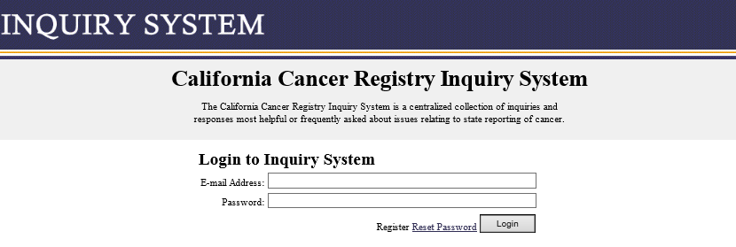
Login/Register/Reset Password for CCRIS
Access CCRIS by:
  Direct Link: https://paqc.ccrcal.org/logon
    CCR Inquiry System
      Login to Inquiry System page

Slide 4
Login/Register/Reset Password for CCRIS, continued…
    Login:
      Fill in items in your email address
      Enter your password
      Choose “Login”

Slide 5
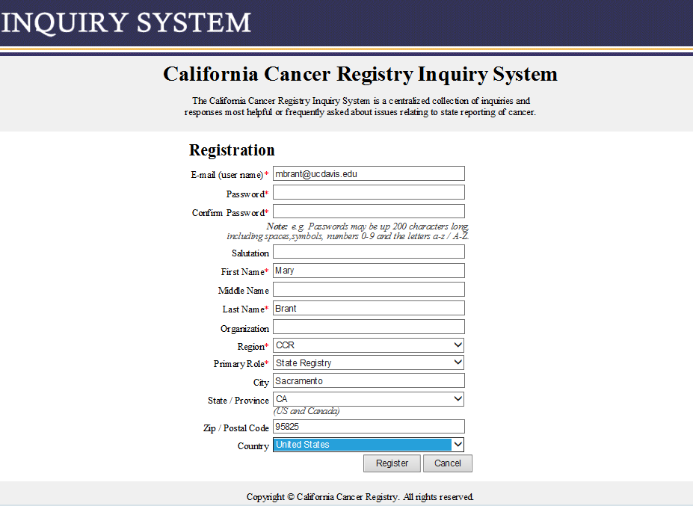
Login/Register/Reset Password for CCRIS, continued…
    Registration:
      Choose “Register” on the login page
      Fill in items in registration page
      Click “Register”

Slide 6
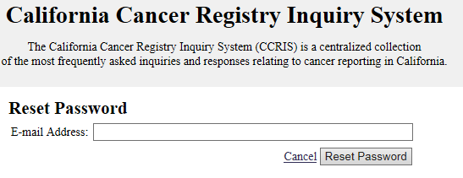
Login/Register/Reset Password for CCRIS, continued…
    Reset Password:
      Choose “Reset Password” on the login page
      Enter the email address associated with your CCRIS account
      Click “Reset Password”(an email will be sent to this account)

Slide 7
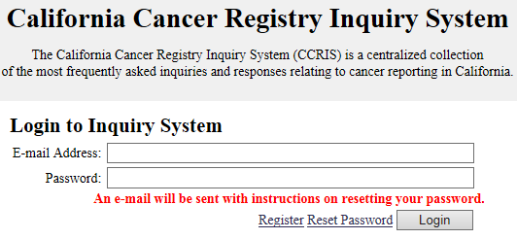
Login/Register/Reset Password for CCRIS, continued…
    Reset Password, continued…
      Note: you are notified that an email will be sent to you.
      Login to your email and click the link provided.
        If you are having trouble obtaining the email, try looking in your clutter/spam/or junk folders

Slide 8
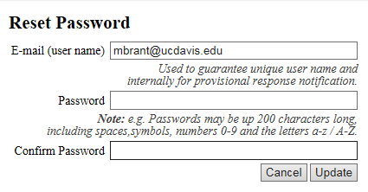
Login/Register/Reset Password for CCRIS, continued…
    Reset Password, continued…
      Enter the required items
        Email (this is your user name)
        Password
        Confirm Password
      Choose “update”

Slide 9
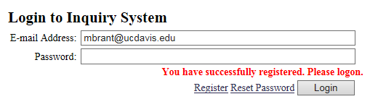
Login/Register/Reset Password for CCRIS, continued…
    Reset Password, continued…
      Note: you are notified that you have successfully registered.
    Enter your new password.
    Choose “Login”
    You are now logged in.

Slide 10
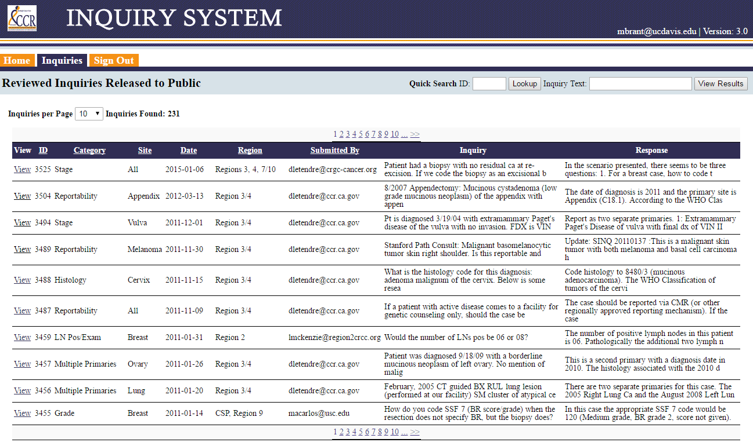
View Inquiries
Select the “Inquiries” Tab - A list of all inquiries will appear
  Inquiries will be:
    In descending date order by default
    Sortable by clicking on column header
    Viewable by clicking “View” (in the far left column)

Slide 11
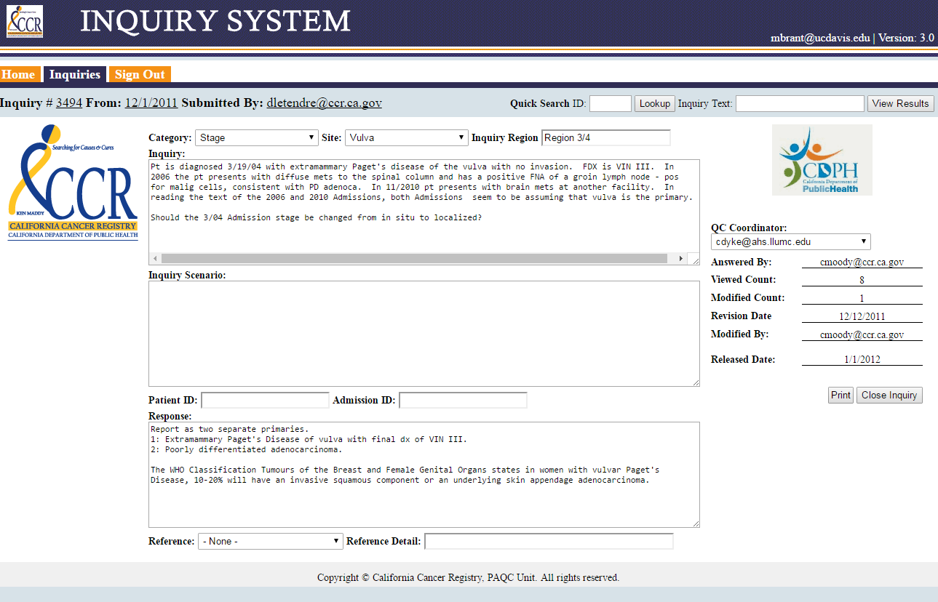
View Inquiries, cont…
Example of an Inquiry

Slide 12
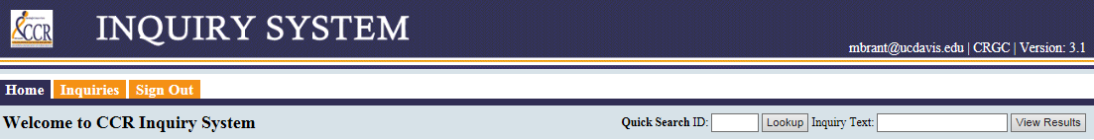
Search Inquiries
Searches can be conducted in any tab at the top of the screen by entering:
  The Inquiry ID in the “Quick Search ID” field
    Choose “Lookup” to view the inquiry
  Text in the “Inquiry Text” field
    Choose “Lookup” to view the inquiry

Slide 13
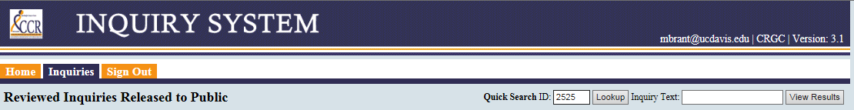
Search Inquiries, cont…
Example of Quick Search ID using the Inquiry ID:
  Enter Inquiry ID in the “Quick Search ID” box
  Click the “Lookup” button
  The inquiry will display (see next slide)

Slide 14
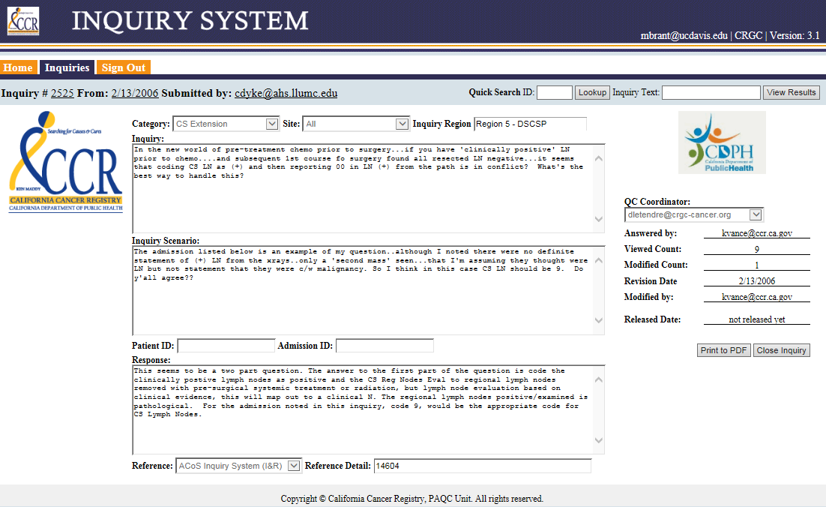
Search Inquiries, cont…
Display of inquiry search using “Quick Search ID”

Slide 15
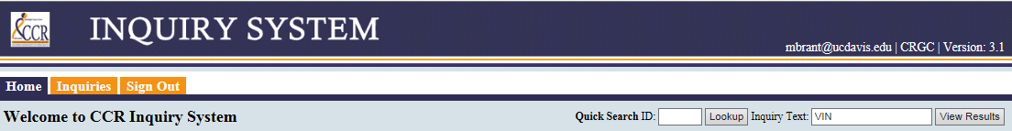
Search Inquiries, cont…
Example of Quick Search Inquiry Text:
  Enter text into the “Inquiry Text” Box
  Click the “View Results” button
  The inquiry will display (see next slide)

Slide 16
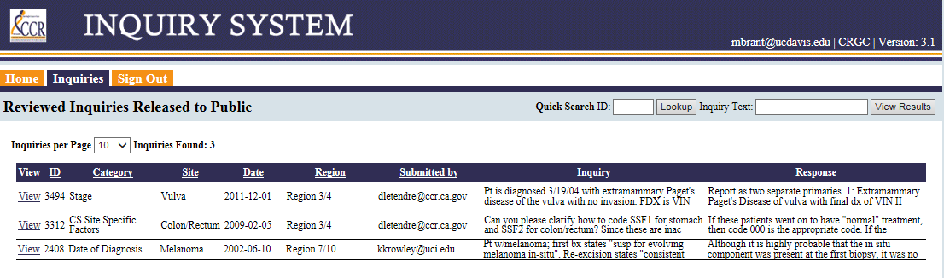
Search Inquiries, cont…
Display of inquiry search using “Inquiry Text”
  Three Inquiries are listed within the “VIN” text search

Slide 17
Print Inquiries
To Print an inquiry:
  Open an Inquiry
  Click on the “Print to PDF” button
  The PDF Will Display (see next slide)

Slide 18
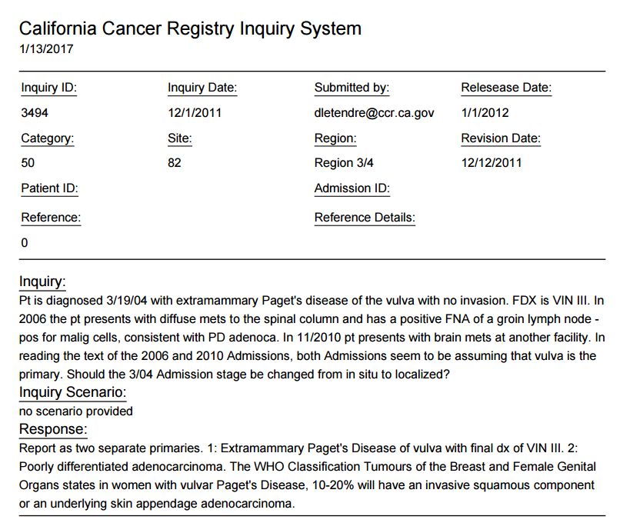
Print Inquiries, cont…
Display of inquiry search using “Print to PDF”

Slide 19

Sign Out
To log out of the Inquiry system click the “Sign Out” tab

Slide 20

Brought to you by…
Ghenadie Ciornii
Mary Brant
Rajiv Kairon
For Questions
Contact:
Mary Brant, CTR
Email: mbrant@ccr.ca.gov

